Slide 1
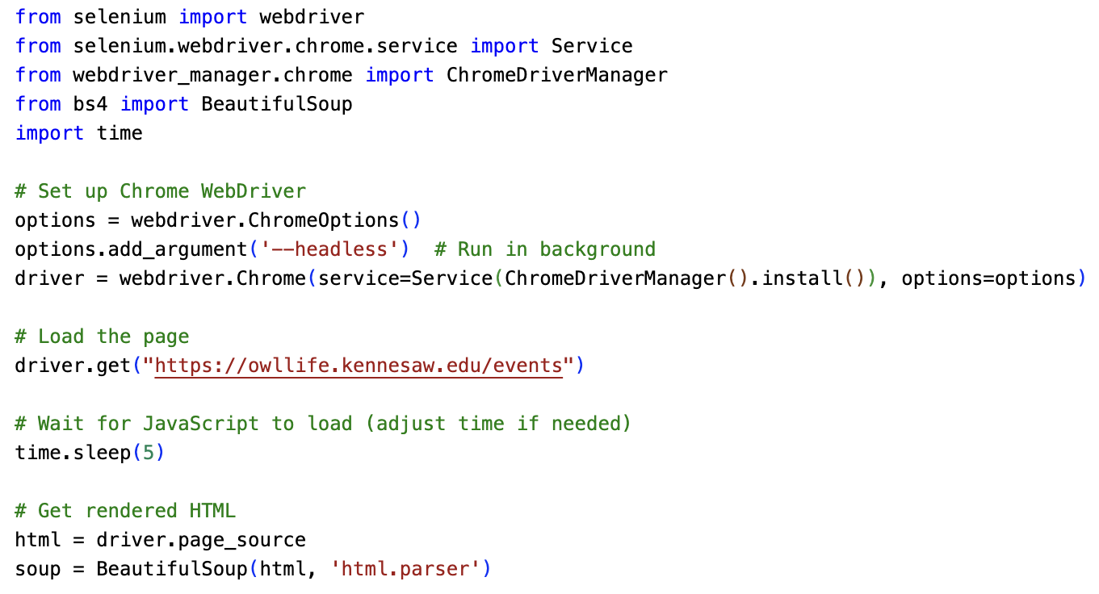

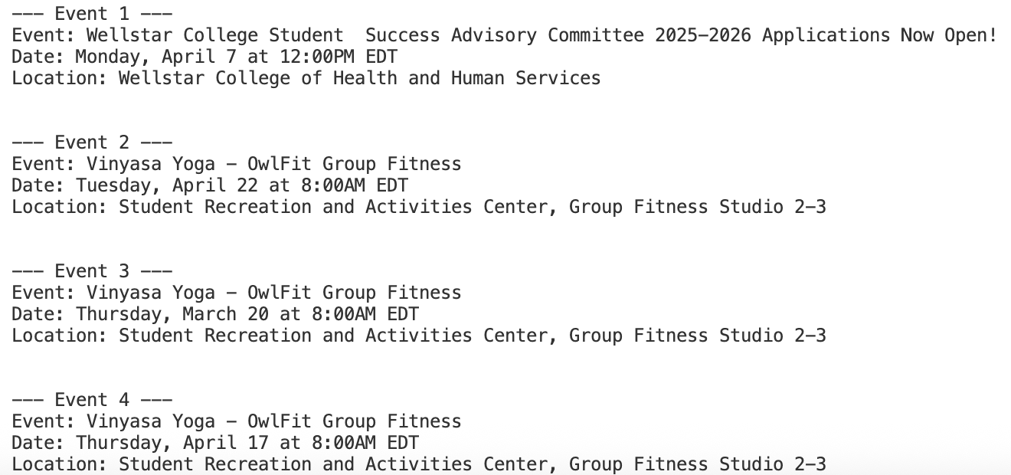
All Campus Events
… in one place
Name: Winola Florent
GitHub Repository

